Slide 1
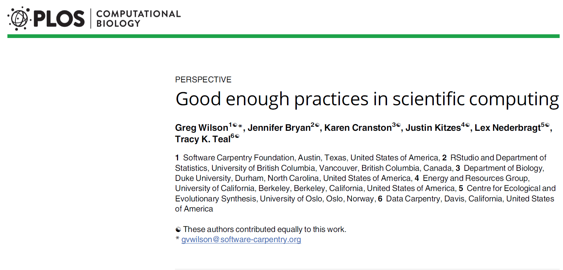

Slide 2
Abstract
Many of the tools and methods proven to work in the field of software development can also help you with your data analysis. Following closely the recommendations in Wilson et al “Good enough practices in scientific computing” published in PLoS Computational Biology, you will learn how to apply modern techniques that will improve your ability to work with the other members of your research team, help to attract new collaborators, and insure the production high quality reproducible results. These techniques require that you break long entrenched habits, but you can adopt them no matter what your level of computer expertise.
Plagiarism disclaimer. All the major headings (1. Data management) and first level subheadings (Save the raw data (1a)) are direct quotes from the paper. Second level subheadings are paraphrases or independent observations.

Slide 3
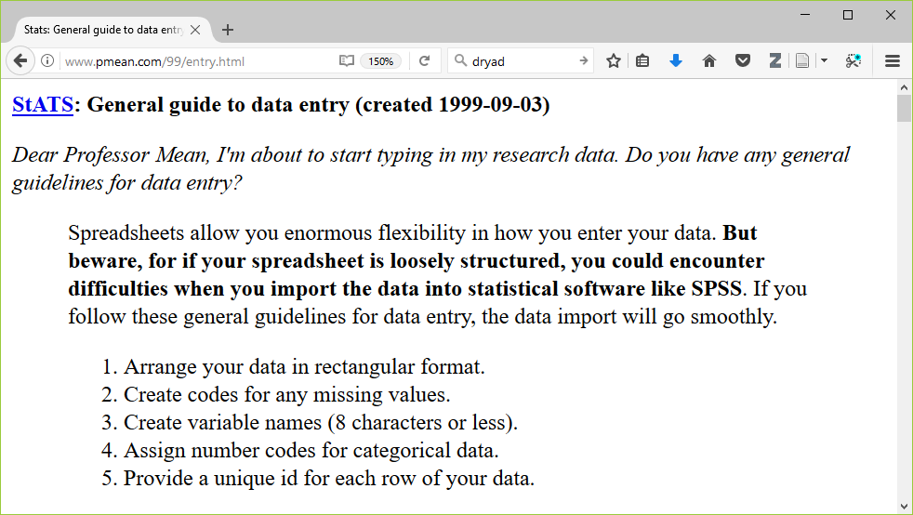
Obsolete

Slide 4
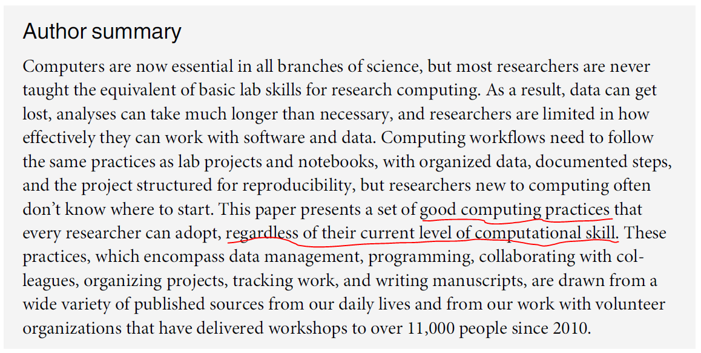

Slide 5
Why should you adopt “good enough programming practices”?
If you adopt good programming practices, you will…
make your job easier today. (only partially true!)
make your job easier six months down the road when you have to dust off your work and dig in again.
help everyone who is currently working with you.
encourage future collaborators to work with you.
make your research more reproducible.
enhance the quality of your publications.
But, it requires time and energy and the breaking of many old habits.

Slide 6
Recommendations in six areas
1. Data management. Work incrementally, backup your efforts, and document everything. This allows you to reverse course easily if you’ve gone down a blind alley. It saves you time if you are presented later with “the correct” data. Finally, good data management makes it easier for someone else to replicate your work.
2. Software.
3. Collaboration.
4. Project organization.
5. Keeping track of changes.
6. Manuscripts.

Slide 7
1. Data management
Save the raw data (1a, page 2).
Never make changes directly on top of the data you receive.
Note the version number and date of any data you receive remotely.
Ensure that raw data are backed up in more than one location (1b, page 4).
Create the data you wish to see in the world (1c, page 4).
Create analysis-friendly data (1d, page 5).
Record all the steps used to process data (1e, page 5).
Anticipate the need to use multiple tables and use a unique identifier for every record (1f, page 5).
Submit data to a reputable DOI-issuing repository so that others can access and cite it (1g, page 6).

Slide 8
1. Data management
Save the raw data (1a, page 2).
Ensure that raw data are backed up in more than one location (1b, page 4).
Your company/university network may include remote back up, but check first.
You can also use cloud services or your own USB stick/drive, but be sure to encrypt anything confidential.
Create the data you wish to see in the world (1c, page 4).
Create analysis-friendly data (1d, page 5).
Record all the steps used to process data (1e, page 5).
Anticipate the need to use multiple tables and use a unique identifier for every record (1f, page 5).
Submit data to a reputable DOI-issuing repository so that others can access and cite it (1g, page 6).

Slide 9
1. Data management
Save the raw data (1a, page 2).
Ensure that raw data are backed up in more than one location (1b, page 4).
Create the data you wish to see in the world (1c, page 4).
Use open formats like csv, json, yaml, or xml.
Replace cryptic names with self-explaining alternatives.
Create analysis-friendly data (1d, page 5).
Record all the steps used to process data (1e, page 5).
Anticipate the need to use multiple tables and use a unique identifier for every record (1f, page 5).
Submit data to a reputable DOI-issuing repository so that others can access and cite it (1g, page 6).

Slide 10
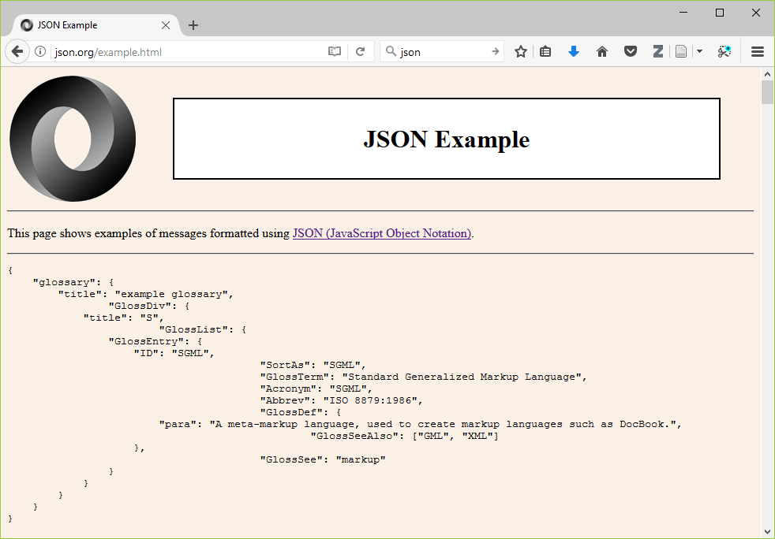

Slide 11
1. Data management
Save the raw data (1a, page 2).
Ensure that raw data are backed up in more than one location (1b, page 4).
Create the data you wish to see in the world (1c, page 4).
Create analysis-friendly data (1d, page 5).
Each column is a variable. (No double dipping).
Make each row an observation (use a tall/thin format).
Record all the steps used to process data (1e, page 5).
Anticipate the need to use multiple tables and use a unique identifier for every record (1f, page 5).
Submit data to a reputable DOI-issuing repository so that others can access and cite it (1g, page 6).

Slide 12
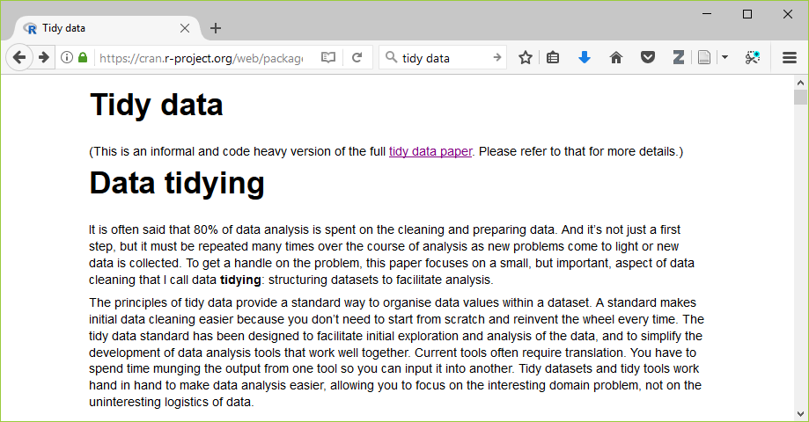

Slide 13
1. Data management
Save the raw data (1a, page 2).
Ensure that raw data are backed up in more than one location (1b, page 4).
Create the data you wish to see in the world (1c, page 4).
Create analysis-friendly data (1d, page 5).
Record all the steps used to process data (1e, page 5).
Write scripts/use syntax instead of a graphical user interface.
If you can’t use scripts/syntax, hand document all your steps.
Anticipate the need to use multiple tables and use a unique identifier for every record (1f, page 5).
Submit data to a reputable DOI-issuing repository so that others can access and cite it (1g, page 6).

Slide 14
1. Data management
Save the raw data (1a, page 2).
Ensure that raw data are backed up in more than one location (1b, page 4).
Create the data you wish to see in the world (1c, page 4).
Create analysis-friendly data (1d, page 5).
Record all the steps used to process data (1e, page 5).
Anticipate the need to use multiple tables and use a unique identifier for every record (1f, page 5).
This allows you to split your data into pieces (e.g., time-constant and time-varying data in a longitudinal study).
Submit data to a reputable DOI-issuing repository so that others can access and cite it (1g, page 6).

Slide 15
1. Data management
Save the raw data (1a, page 2).
Ensure that raw data are backed up in more than one location (1b, page 4).
Create the data you wish to see in the world (1c, page 4).
Create analysis-friendly data (1d, page 5).
Record all the steps used to process data (1e, page 5).
Anticipate the need to use multiple tables and use a unique identifier for every record (1f, page 5).
Submit data to a reputable DOI-issuing repository so that others can access and cite it (1g, page 6).
DOI is Digital Object Identifier, which assigns a permanent and unchanging URL.
Include a README file with information that will simplify the task of others using your data.

Slide 16
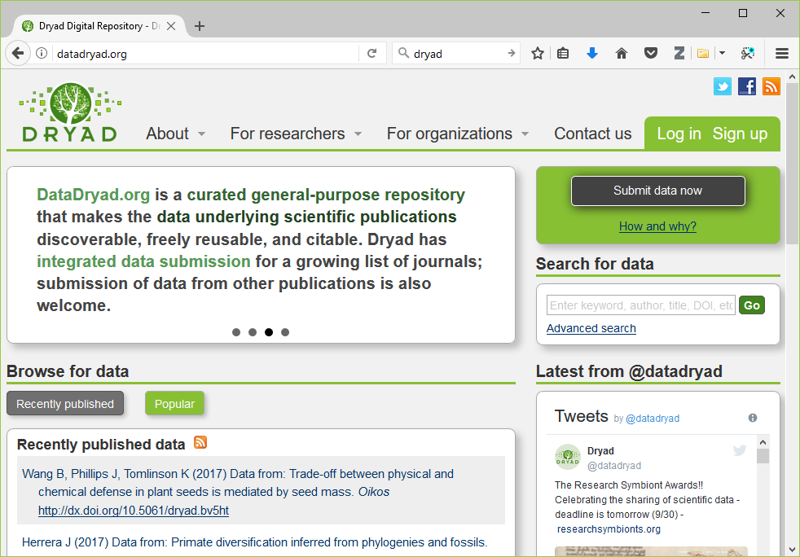

Slide 17
1. Data management. What do you think?
Save the raw data (1a, page 2).
Ensure that raw data are backed up in more than one location (1b, page 4).
Create the data you wish to see in the world (1c, page 4).
Create analysis-friendly data (1d, page 5).
Record all the steps used to process data (1e, page 5).
Anticipate the need to use multiple tables and use a unique identifier for every record (1f, page 5).
Submit data to a reputable DOI-issuing repository so that others can access and cite it (1g, page 6).

Slide 18
Recommendations in six areas
1. Data management.
2. Software. The program that you write to analyze your data is software, and software can be improved through the use of well-tested software development methods.
3. Collaboration.
4. Project organization.
5. Keeping track of changes.
6. Manuscripts.

Slide 19
2. Software (a-e)
Place a brief explanatory comment at the start of every program (2a, page 6).
Give an example of how it is used, and explain what parameters are needed.
Write the explanatory comment BEFORE you write your program, and revise it as needed as you revise your program.
Decompose programs into functions (2b, page 7).
Be ruthless about eliminating duplication (2c, page 7).
Always search for well-maintained libraries that do what you need (2d, page 7).
Test libraries before relying on them (2e, page 7).

Slide 20
2. Software (a-e)
Place a brief explanatory comment at the start of every program (2a, page 6).
Decompose programs into functions (2b, page 7).
This really means using macros for programs like SPSS and SAS.
Keep it short: one page and no more than 6 input parameters.
Do not reference information outside the function.
Be ruthless about eliminating duplication (2c, page 7).
Always search for well-maintained libraries that do what you need (2d, page 7).
Test libraries before relying on them (2e, page 7).

Slide 21
2. Software (a-e)
Place a brief explanatory comment at the start of every program (2a, page 6).
Decompose programs into functions (2b, page 7).
Be ruthless about eliminating duplication (2c, page 7).
DRY code (don’t repeat yourself).
Cut, paste, and slightly modify is your enemy.
Always search for well-maintained libraries that do what you need (2d, page 7).
Test libraries before relying on them (2e, page 7).

Slide 22
2. Software (a-e)
Place a brief explanatory comment at the start of every program (2a, page 6).
Decompose programs into functions (2b, page 7).
Be ruthless about eliminating duplication (2c, page 7).
Always search for well-maintained libraries that do what you need (2d, page 7).
Don’t be a Frank Sinatra programmer (“I did it my way.”)
Test libraries before relying on them (2e, page 7).

Slide 23
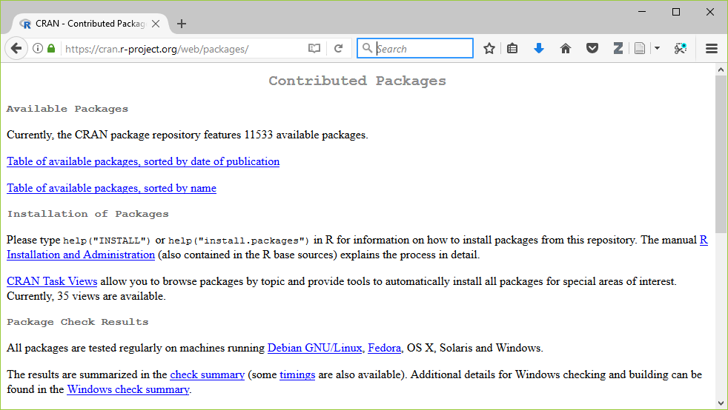

Slide 24
2. Software (a-e)
Place a brief explanatory comment at the start of every program (2a, page 6).
Decompose programs into functions (2b, page 7).
Be ruthless about eliminating duplication (2c, page 7).
Always search for well-maintained libraries that do what you need (2d, page 7).
Test libraries before relying on them (2e, page 7).
It might be more practical to say “evaluate libraries” rather than “test libraries.”

Slide 25
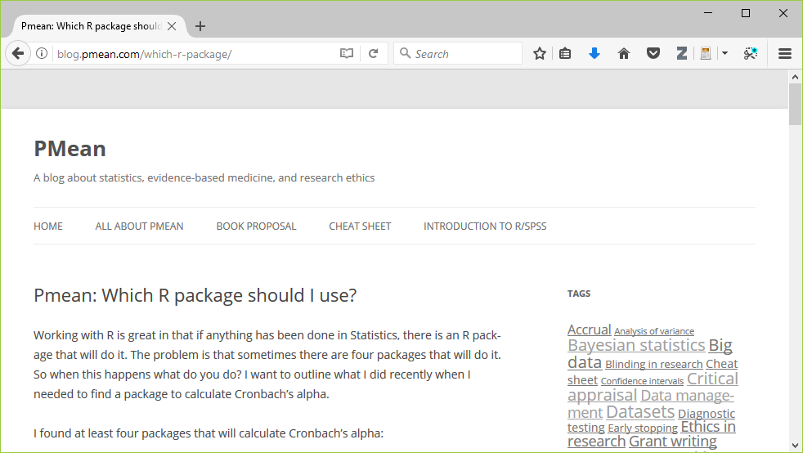

Slide 26
2. Software (a-e). What do you think?
Place a brief explanatory comment at the start of every program (2a, page 6).
Decompose programs into functions (2b, page 7).
Be ruthless about eliminating duplication (2c, page 7).
Always search for well-maintained libraries that do what you need (2d, page 7).
Test libraries before relying on them (2e, page 7).

Slide 27
2. Software (f-j)
Give functions and variables meaningful names (2f, page 7).
Functions are verbs and variables are nouns.
With the exception of loop counters, avoid one character variable names.
Be consistent with your names (CamelCase, dot.delimiters, or underscore_delimiters) and with case (lower_case, Title_Case, or UPPER_CASE).
Make dependencies explicit (2g, page 7).
Do not comment and uncomment sections of code to control a program’s behavior (2h, page 8).
Provide a simple example or test data set (2i, page 8).
Submit your code to a reputable DOI-issuing repository (2j, page 8).

Slide 28
2. Software (f-j)
Give functions and variables meaningful names (2f, page 7).
Make dependencies explicit (2g, page 7).
Dependencies include what version of the software you need (e.g., 3.1.0 or later) and what additional software or libraries you need. Document this as part of README, or in REQUIREMENTS.TXT.
Do not comment and uncomment sections of code to control a program’s behavior (2h, page 8).
Provide a simple example or test data set (2i, page 8).
Submit your code to a reputable DOI-issuing repository (2j, page 8).

Slide 29
2. Software (f-j)
Give functions and variables meaningful names (2f, page 7).
Make dependencies explicit (2g, page 7).
Do not comment and uncomment sections of code to control a program’s behavior (2h, page 8).
Use if/else statements and verbose/debug flags instead.
Don’t keep old code around for historical reference, use version control instead.
Provide a simple example or test data set (2i, page 8).
Submit your code to a reputable DOI-issuing repository (2j, page 8).

Slide 30
2. Software (f-j)
Give functions and variables meaningful names (2f, page 7).
Make dependencies explicit (2g, page 7).
Do not comment and uncomment sections of code to control a program’s behavior (2h, page 8).
Provide a simple example or test data set (2i, page 8).
Run these tests when you switch computers, upgrade to a new software version, or add new pieces to your program.
Submit your code to a reputable DOI-issuing repository (2j, page 8).

Slide 31
2. Software (f-j)
Give functions and variables meaningful names (2f, page 7).
Make dependencies explicit (2g, page 7).
Do not comment and uncomment sections of code to control a program’s behavior (2h, page 8).
Provide a simple example or test data set (2i, page 8).
Submit your code to a reputable DOI-issuing repository (2j, page 8).
When you share both your data and your code, you help insure reproducibility and you encourage new collaborations.

Slide 32
2. Software (f-j). What do you think?
Give functions and variables meaningful names (2f, page 7).
Make dependencies explicit (2g, page 7).
Do not comment and uncomment sections of code to control a program’s behavior (2h, page 8).
Provide a simple example or test data set (2i, page 8).
Submit your code to a reputable DOI-issuing repository (2j, page 8).

Slide 33
Recommendations in six areas
1. Data management.
2. Software.
3. Collaboration: use development approaches that allow a team to work well together. Even if you are a team of one, use these tools to make it easy for others to follow in your footsteps.
4. Project organization.
5. Keeping track of changes.
6. Manuscripts.

Slide 34
3. Collaboration
Create an overview of your project (3a, page 8).
This is useful even if you work alone, because it gives a focus to your work.
Store the overview in a README file.
Include information about opportunities for collaboration in a CONTRIBUTING file.
Create a shared to-do list (3b, page 8).
Decide on communication strategies (3c, page 8).
Make the license explicit (3d, page 9).
Make the project citable (3e, page 10).

Slide 35
3. Collaboration
Create an overview of your project (3a, page 8).
Create a shared to-do list (3b, page 8).
Document this well enough for an outsider to understand.
Decide on communication strategies (3c, page 8).
Make the license explicit (3d, page 9).
Make the project citable (3e, page 10).

Slide 36
3. Collaboration
Create an overview of your project (3a, page 8).
Create a shared to-do list (3b, page 8).
Decide on communication strategies (3c, page 8).
Where and how will your team meet to resolve issues.
Explain how new collaborators can get involved.
Specify where key documents are stored and who can modify them.
Make the license explicit (3d, page 9).
Make the project citable (3e, page 10).

Slide 37
3. Collaboration
Create an overview of your project (3a, page 8).
Create a shared to-do list (3b, page 8).
Decide on communication strategies (3c, page 8).
Make the license explicit (3d, page 9).
Use a liberal license that makes it easy for future collaborators to join in the fun.
Remember that you are far better off being the pioneer in a new research area that everyone is working in than a new research area that no one is working in.
“A candle loses nothing by lighting another candle.” James Keller
Make the project citable (3e, page 10).

Slide 38
3. Collaboration
Create an overview of your project (3a, page 8).
Create a shared to-do list (3b, page 8).
Decide on communication strategies (3c, page 8).
Make the license explicit (3d, page 9).
Make the project citable (3e, page 10).
Include a suggested citation for your work in a CITATION file.
Put a footer at the end of every text document like
“This text is licensed under the CC BY 4.0 license (creativecommons.org/licenses/by/4.0/). Feel free to use or modify anything in this file, but please give appropriate credit when you do. An example of appropriate credit would be ‘thanks to Steve Simon (blog.pmean.com) for sharing this material.’”

Slide 39
3. Collaboration. What do you think?
Create an overview of your project (3a, page 8).
Create a shared to-do list (3b, page 8).
Decide on communication strategies (3c, page 8).
Make the license explicit (3d, page 9).
Make the project citable (3e, page 10).

Slide 40
Recommendations in six areas
1. Data management.
2. Software.
3. Collaboration.
4. Project organization. Standardize where everything goes (data, doc, results, src, and bin subdirectories), so you don’t lose it and others will know where to look.
5. Keeping track of changes.
6. Manuscripts.

Slide 41
4. Project organization
Put each project in its own directory, which is named for the project (4a, page 9).
If two projects share more than 50% of the code or data, then they can be safely combined into one project.
Two projects that share no code or data belong in separate directories.
Use standard names for subdirectories.
Name all files to reflect their content or function (4f, page 11).

Slide 42
4. Project organization
Put each project in its own directory, which is named for the project (4a, page 9).
Use standard names for subdirectories.
README, LICENSE, CITATION, REQUIREMENTS go in root directory.
DOC for most other documentation (4b, page 10).
DATA for raw data (4c, page 10).
RESULTS for intermediate data sets and program output (also 4c, page 10).
SRC for source code (4d, page 10).
BIN for compiled programs (4e, page 10).
Name all files to reflect their content or function (4f, page 11).

Slide 43
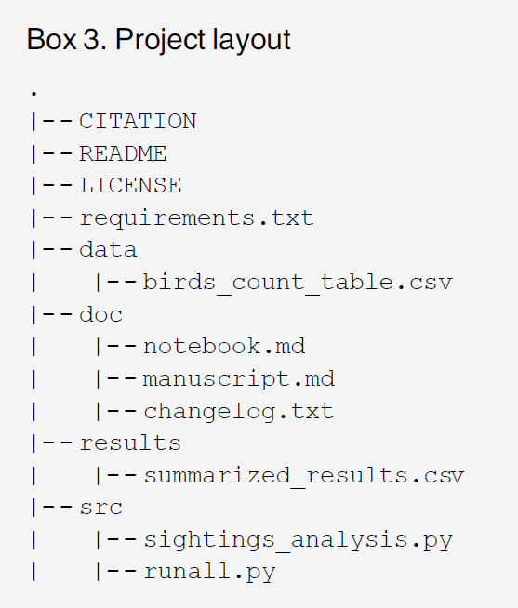

Slide 44
4. Project organization
Put each project in its own directory, which is named for the project (4a, page 9).
Use standard names for subdirectories.
Name all files to reflect their content or function (4f, page 11).
Avoid sequence names like logistic_model1, logistic_model2, … as these are not descriptive and subject to frequent renumbering. Better would be simple_logistic_model, cubic_spline_logistic_model, …

Slide 45
4. Project organization. What do you think?
Put each project in its own directory, which is named for the project (4a, page 9).
Use standard names for subdirectories.
Name all files to reflect their content or function (4f, page 11).

Slide 46
Recommendations in six areas
1. Data management.
2. Software.
3. Collaboration.
4. Project organization.
5. Keeping track of changes. Adopt a formal system to track changes. It keeps everyone on your team “on the same page” and allows to back out gracefully from a disastrous change. There are manual approaches (using a shared file, CHANGELOG.txt) and automated software (git or subversion) for tracking changes.
6. Manuscripts.

Slide 47
5. Keeping track of changes (manual or automated)
Back up (almost) everything created by a human being as soon as it is created. (5a, page 12).
This is easily automated by programs like dropbox.
If your team is all within the same organization, a shared network folder works well.
Keep changes small (5b, page 12).
Share changes frequently (5c, page 12).

Slide 48
5. Keeping track of changes (manual or automated)
Back up (almost) everything created by a human being as soon as it is created. (5a, page 12).
Keep changes small (5b, page 12).
Any group of edits that you might think about undoing as a batch should be considered a single change.
Share changes frequently (5c, page 12).

Slide 49
5. Keeping track of changes (manual or automated)
Back up (almost) everything created by a human being as soon as it is created. (5a, page 12).
Keep changes small (5b, page 12).
Share changes frequently (5c, page 12).
Do not allow different investigator versions to drift apart.
This is even a problem if you run analyses on both a work and home computer.

Slide 50
5. Keeping track of changes (manual or automated). What do you think?
Back up (almost) everything created by a human being as soon as it is created. (5a, page 12).
Keep changes small (5b, page 12).
Share changes frequently (5c, page 12).

Slide 51
5. Keeping track of changes (manually)
Create, maintain, and use a checklist for saving and sharing changes to the project (5d, page 12).
This is stored as TODO.txt.
Store each project in a folder that is mirrored off the researcher’s working machine (5e, page 12).
Add a file called CHANGELOG.txt to the project’s DOC subfolder (5f, page 13).
Copy the entire project whenever a significant change has been made. (5g, page 13).

Slide 52
5. Keeping track of changes (manually)
Create, maintain, and use a checklist for saving and sharing changes to the project (5d, page 12).
Store each project in a folder that is mirrored off the researcher’s working machine (5e, page 12).
Dropbox can automate this process.
Add a file called CHANGELOG.txt to the project’s DOC subfolder (5f, page 13).
Copy the entire project whenever a significant change has been made. (5g, page 13).

Slide 53
5. Keeping track of changes (manually)
Create, maintain, and use a checklist for saving and sharing changes to the project (5d, page 12).
Store each project in a folder that is mirrored off the researcher’s working machine (5e, page 12).
Add a file called CHANGELOG.txt to the project’s DOC subfolder (5f, page 13).
Date entries and put most recent changes as the top.
Copy the entire project whenever a significant change has been made. (5g, page 13).

Slide 54
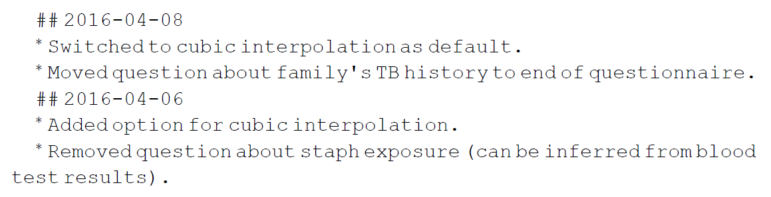

Slide 55
5. Keeping track of changes (manually)
Create, maintain, and use a checklist for saving and sharing changes to the project (5d, page 12).
Store each project in a folder that is mirrored off the researcher’s working machine (5e, page 12).
Add a file called CHANGELOG.txt to the project’s DOC subfolder (5f, page 13).
Copy the entire project whenever a significant change has been made. (5g, page 13).
It is better to waste hardware resources than to waste your time.

Slide 56
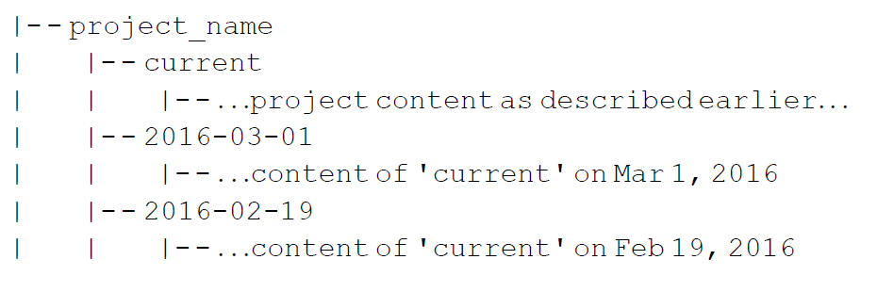

Slide 57
5. Keeping track of changes (manually). What do you think?
Create, maintain, and use a checklist for saving and sharing changes to the project (5d, page 12).
Store each project in a folder that is mirrored off the researcher’s working machine (5e, page 12).
Add a file called CHANGELOG.txt to the project’s DOC subfolder (5f, page 13).
Copy the entire project whenever a significant change has been made. (5g, page 13).

Slide 58
5. Keeping track of changes (automated)
Use a version control system to manage changes to a project (5h, page 14).
Version control tracks the actual changes rather than what you think the changes were.
Version control handles dating automatically.
Version control can rollback changes that you end up regretting.
But…
Do not put large binary files in your version control system.
Avoid putting confidential or proprietary information on a public version control system.
Don’t store passwords for database access on a public version control system.

Slide 59
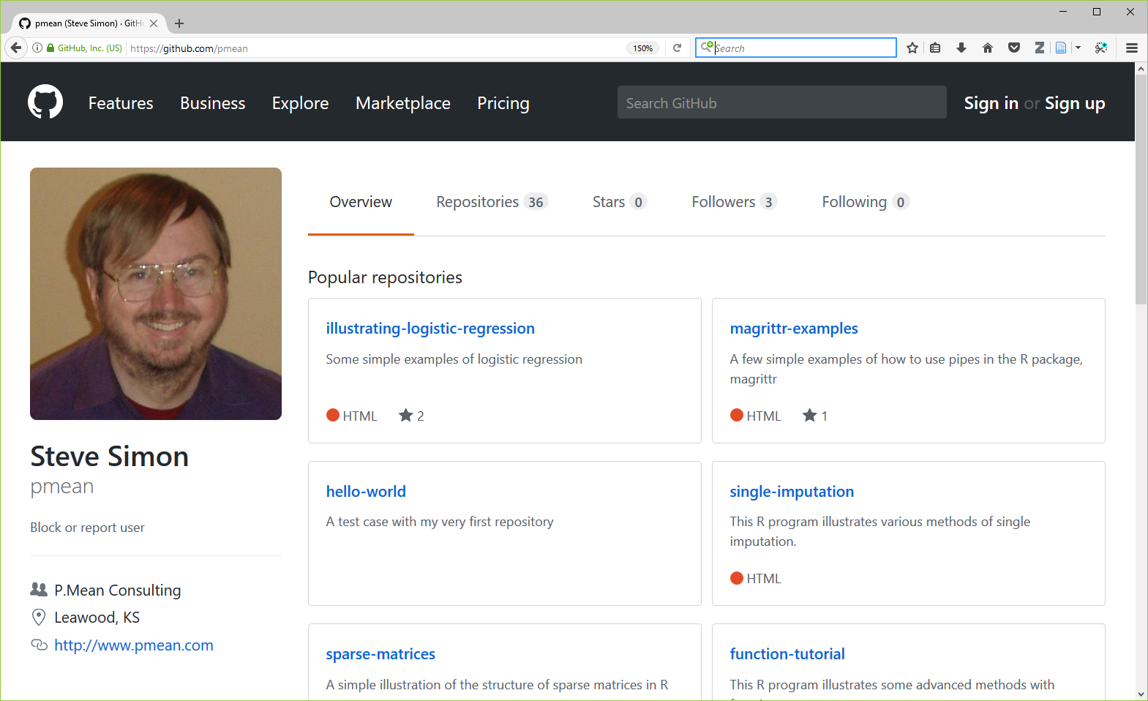

Slide 60
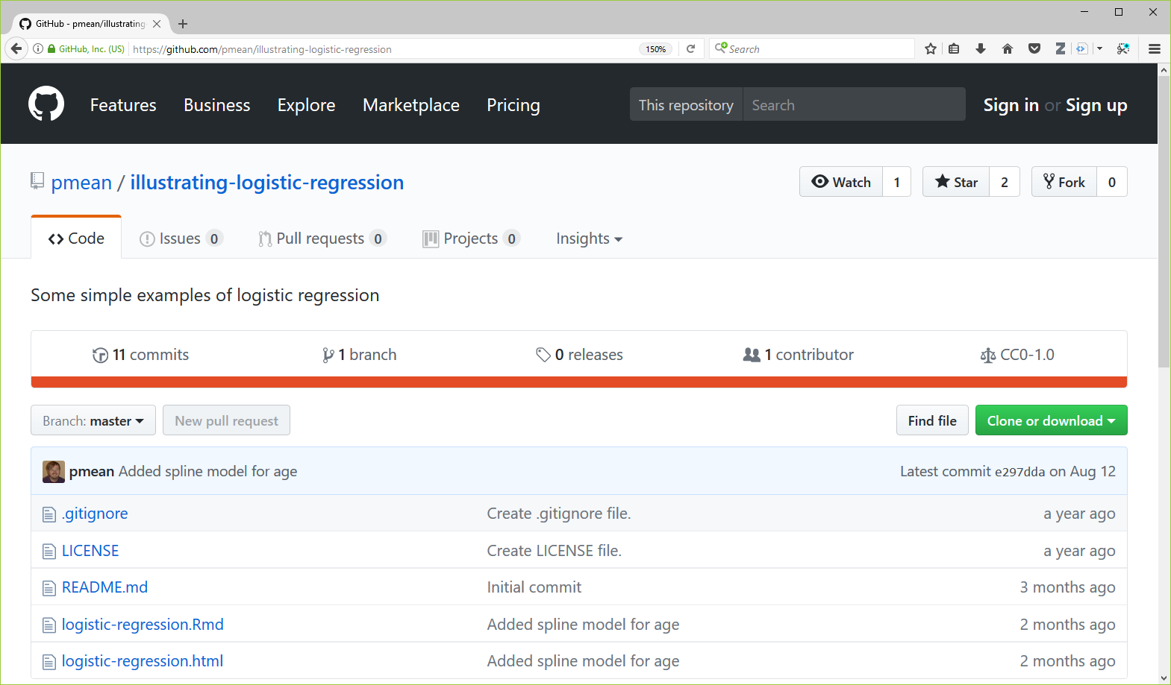

Slide 61
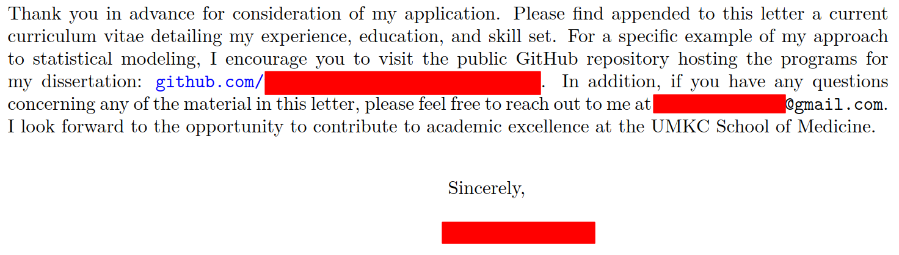

Slide 62
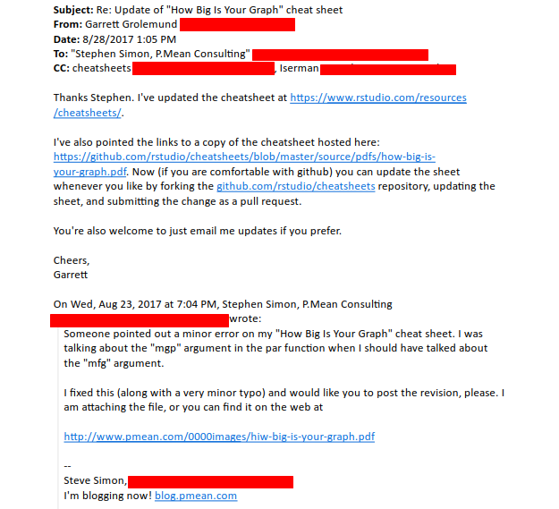

Slide 63
Summary: Keeping track of changes (automated). What do you think?
Use a version control system to manage changes to a project (5h, page 14).

Slide 64
Recommendations in six areas
1. Data management.
2. Software.
3. Collaboration.
4. Project organization.
5. Keeping track of changes.
6. Manuscripts. Prepare your manuscripts using a system that lets everyone collaborate easily. Microsoft Word does not have robust collaboration tools.

Slide 65
6. Manuscripts
Either
Write manuscripts using online tools with rich text formatting, change tracking, and reference management.
Google Docs
Microsoft Word
Or
Write the manuscript in a plain text format that allows version control.
LaTeX.
Markdown.

Slide 66
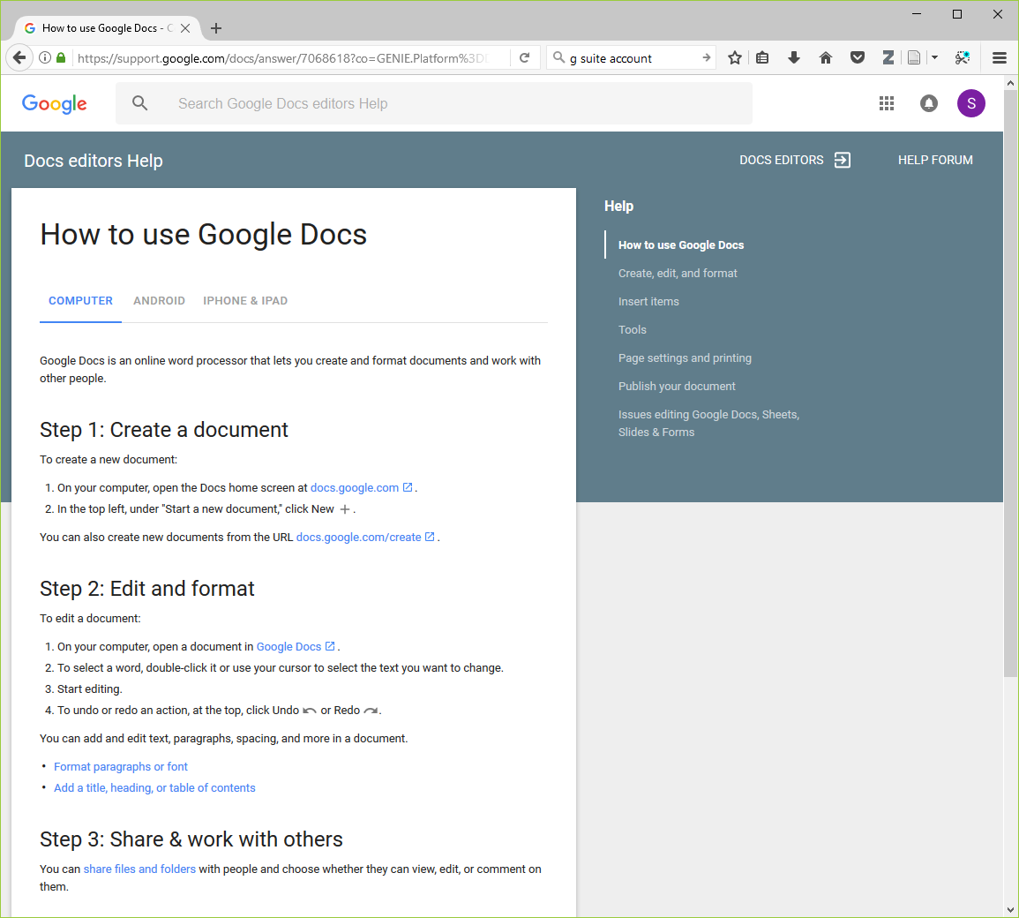

Slide 67
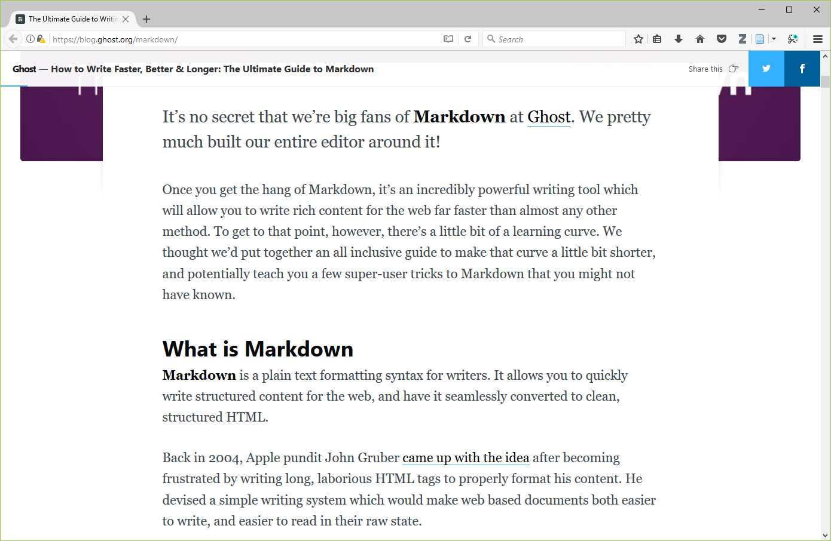

Slide 68
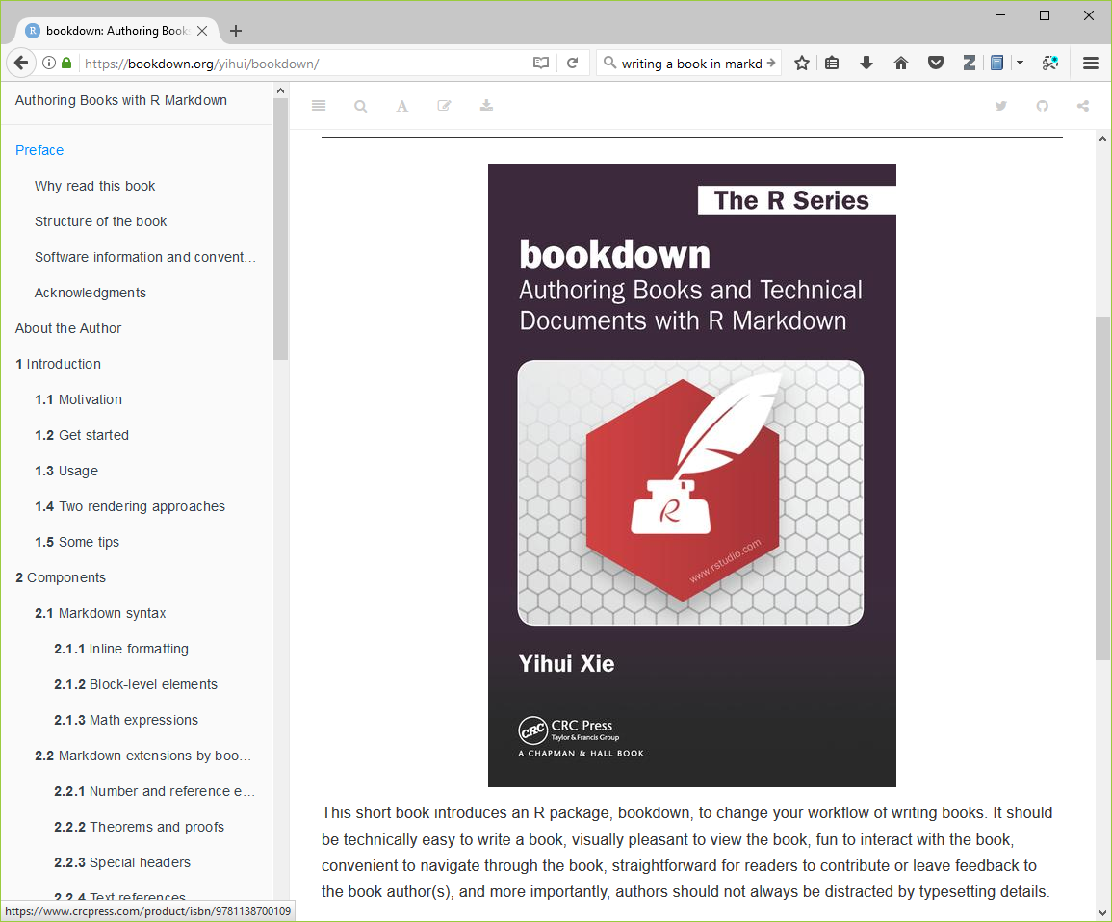

Slide 69
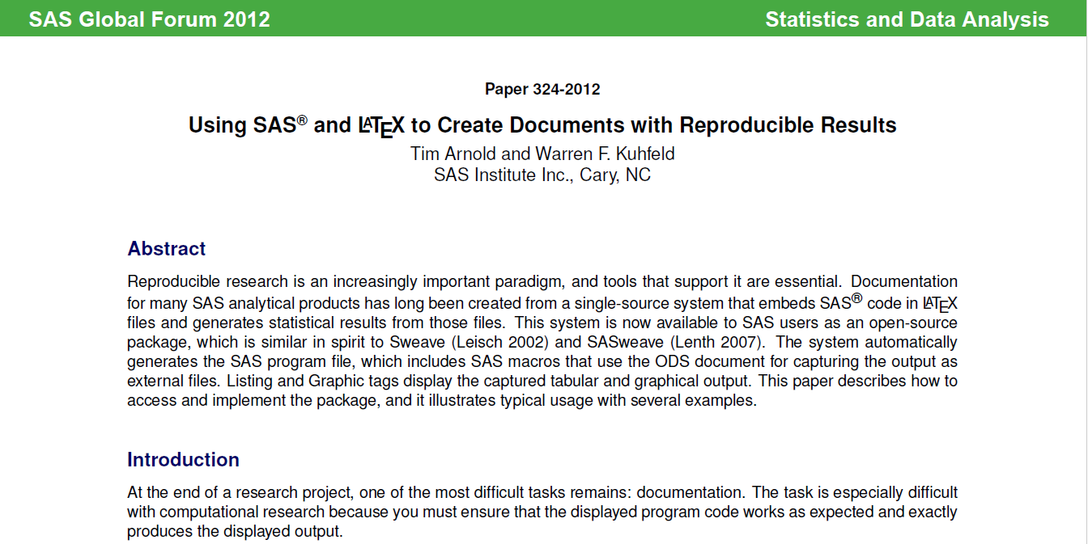

Slide 70
Summary: Manuscripts
Either
Write manuscripts using online tools with rich text formatting, change tracking, and reference management.
Google Docs
Microsoft Word
Or
Write the manuscript in a plain text format that allows version control.
LaTeX.
Markdown.

Slide 71
But wait, there’s more!
Once you get really good at this, consider some more advanced methods (but don’t overwhelm yourself).
Branches: allows better control over changes in version control.
Build tools: “re-compile” everything down to the final paper if your data changes.
Unit tests: rigorous approach to insure quality of your functions.
Coverage: measures what lines are used/ignored to winnow out unused code.
Continuous integration: automate your testing process whenever you make changes.
Profiling: identify parts of your code that are bottlenecks.
The semantic web: using consensus standards for naming things.
Documentation: meaning more than just a few comments here and there.
Bibliography manager: EndNotes / Zotero / Mendeley and get an ORCID number.
Code reviews and pair programming: have a partner to check your work.

Slide 72
Conclusion
Here are the recommendations I see as most important:
Document and save all your data preparation work.
Take the time to write decent code.
Standardize how you archive information from your work.
Share liberally, if you can.

